Slide 1
K Nearest Neighbors

Slide 2
KNN - Definition
KNN is a simple algorithm that stores all available cases and classifies new cases based on a similarity measure

Slide 3
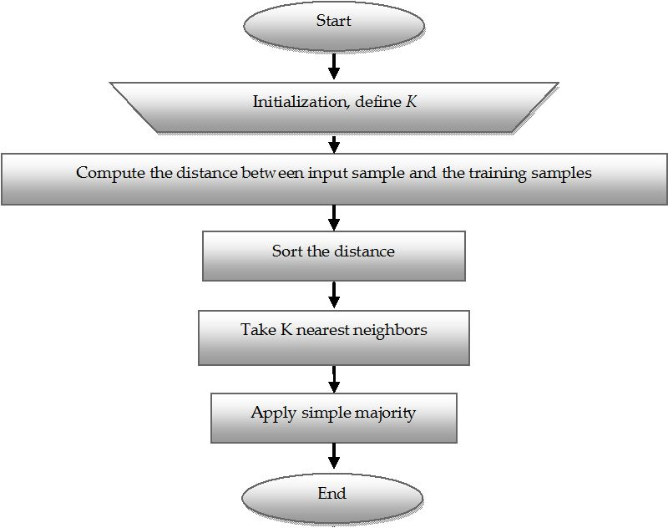
KNN - Definition

Slide 4
KNN – Number of Neighbors
If K=1, select the nearest neighbor
If K>1,
  For classification select the most frequent neighbor.
  For regression calculate the average of K neighbors.

Slide 5
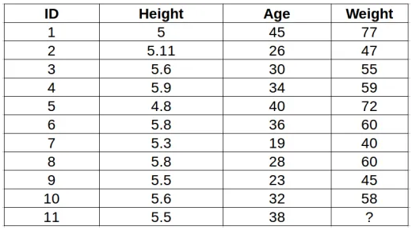
A simple example to understand the intuition behind KNN
Table consists of the height, age and weight (target) value for 10 people. As you can see, the weight value of ID11 is missing. We need to predict the weight of this person based on their height and age.

Slide 6
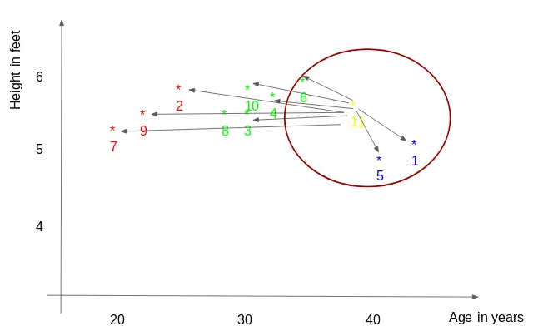
A simple example to understand the intuition behind KNN
Table consists of the height, age and weight (target) value for 10 people. As you can see, the weight value of ID11 is missing. We need to predict the weight of this person based on their height and age.
For a value k = 3, the closest points are ID1, ID5 and ID6.
The average of these data points is the final prediction for the new point. Here, we have weight of ID11 = (77+72+60)/3 = 69.66 kg.

Slide 7
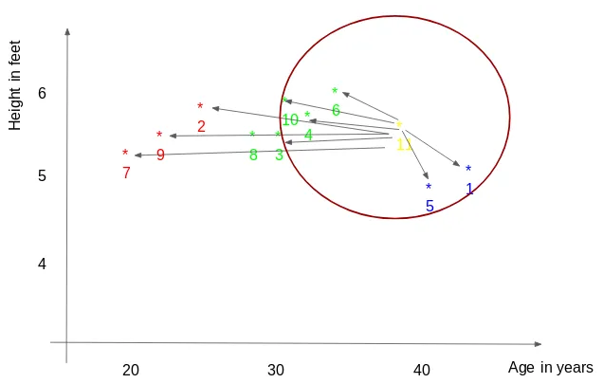
A simple example to understand the intuition behind KNN
Table consists of the height, age and weight (target) value for 10 people. As you can see, the weight value of ID11 is missing. We need to predict the weight of this person based on their height and age.
For the value of k=5, the closest point will be ID1, ID4, ID5, ID6, ID10.
ID 11 = (77+59+72+60+58)/5 = 65.2 kg

Slide 8
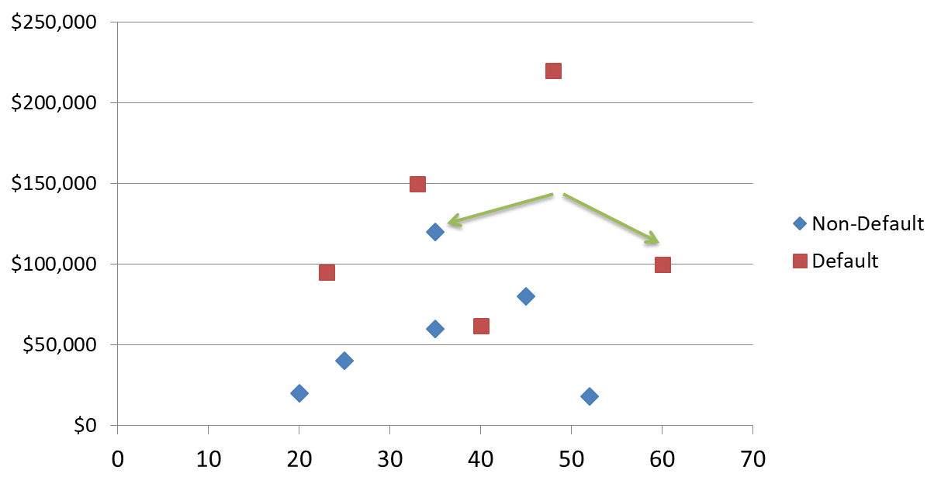

KNN Classification
Loan$
Age

Slide 9
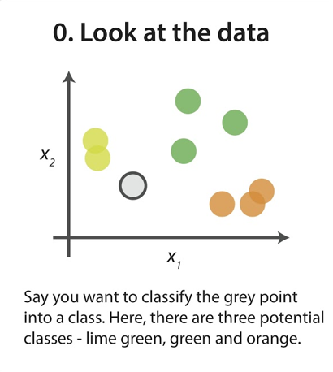
KNN Classification

Slide 10
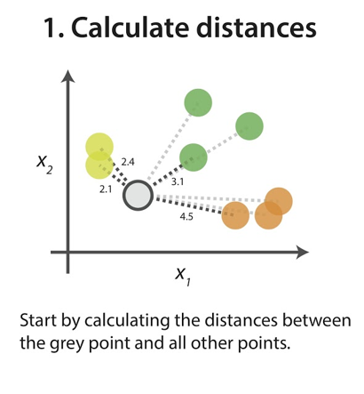
KNN Classification

Slide 11
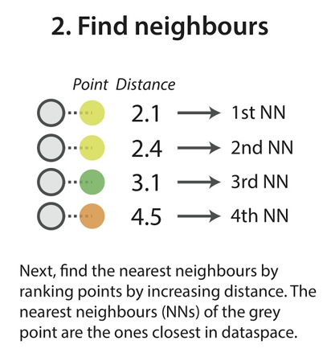
KNN Classification

Slide 12
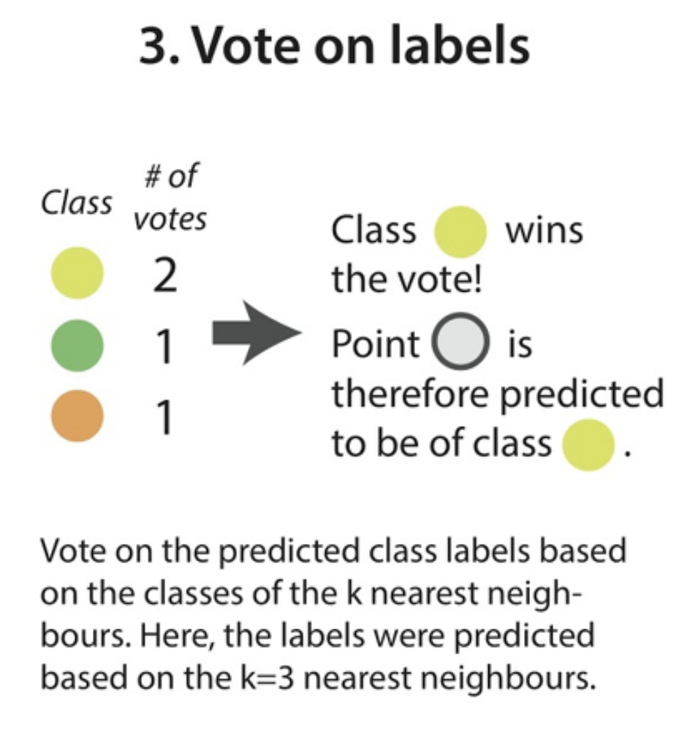
KNN Classification

Slide 13

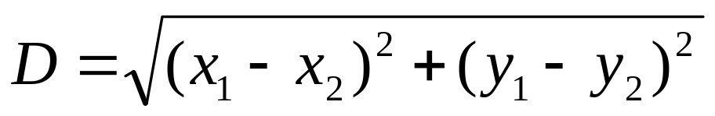
KNN Classification – Distance
Age | Loan | Default | Distance
25 | $40,000 | N | 102000
35 | $60,000 | N | 82000
45 | $80,000 | N | 62000
20 | $20,000 | N | 122000
35 | $120,000 | N | 22000
52 | $18,000 | N | 124000
23 | $95,000 | Y | 47000
40 | $62,000 | Y | 80000
60 | $100,000 | Y | 42000
48 | $220,000 | Y | 78000
33 | $150,000 | Y | 8000
48 | $142,000 | ?
2
3
1
Euclidean Distance

Slide 14

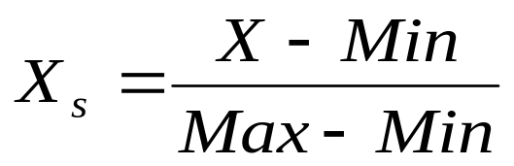
KNN Classification – Standardized Distance
One major drawback in calculating distance measures directly from the training set is in the case where variables have different measurement scales For example, if one variable is based on annual income in dollars, and the other is based on age in years then income will have a much higher influence on the distance calculated. One solution is to standardize the training set as shown below.
Age | Loan | Default | Distance
0.125 | 0.11 | N | 0.7652
0.375 | 0.21 | N | 0.5200
0.625 | 0.31 | N | 0.3160
0 | 0.01 | N | 0.9245
0.375 | 0.50 | N | 0.3428
0.8 | 0.00 | N | 0.6220
0.075 | 0.38 | Y | 0.6669
0.5 | 0.22 | Y | 0.4437
1 | 0.41 | Y | 0.3650
0.7 | 1.00 | Y | 0.3861
0.325 | 0.65 | Y | 0.3771
0.7 | 0.61 | ?
Standardized Variable

Slide 15
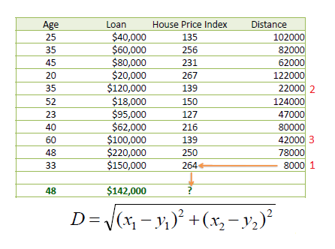
KNN Regression - Distance
Consider the following data concerning House Price Index or HPI. Age and Loan are two numerical variables (predictors) and HPI is the numerical target.
If K=1 then the nearest neighbor is the last case in the training set with HPI=264.
By having K=3, the prediction for HPI is equal to the average of HPI for the top three neighbors.
HPI = (264+139+139)/3 = 180.7

Slide 16
KNN Regression – Standardized Distance
Age | Loan | House Price Index | Distance
0.125 | 0.11 | 135 | 0.7652
0.375 | 0.21 | 256 | 0.5200
0.625 | 0.31 | 231 | 0.3160
0 | 0.01 | 267 | 0.9245
0.375 | 0.50 | 139 | 0.3428
0.8 | 0.00 | 150 | 0.6220
0.075 | 0.38 | 127 | 0.6669
0.5 | 0.22 | 216 | 0.4437
1 | 0.41 | 139 | 0.3650
0.7 | 1.00 | 250 | 0.3861
0.325 | 0.65 | 264 | 0.3771
0.7 | 0.61 | ?
As mentioned in KNN Classification using the standardized distance on the same training set, the unknown case returned a different neighbor which is not a good sign of robustness.

Slide 17
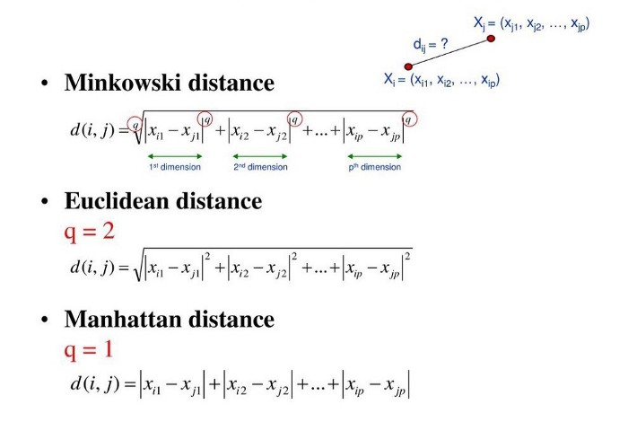
Distance Metrics
Copyright iSmartsoft Inc. 2008
www.ismartsoft.com

Slide 18
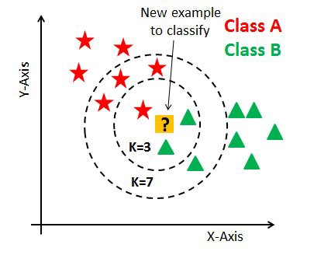
How to choose a K value?
Copyright iSmartsoft Inc. 2008
www.ismartsoft.com

Slide 19
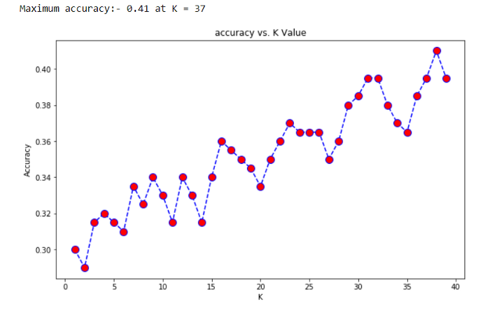
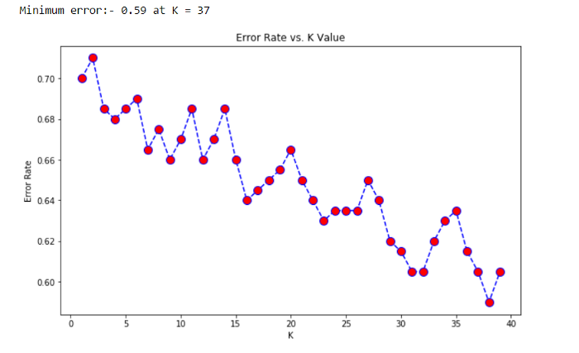
How to choose a K value?
The small K value isn’t suitable for classification.
The optimal K value usually found is the square root of N, where N is the total number of samples.
Use an error plot or accuracy plot to find the most favorable K value
Copyright iSmartsoft Inc. 2008
www.ismartsoft.com

Slide 20
Summary
KNN is conceptually simple, yet able to solve complex problems
Can work with relatively little information
Learning is simple (no learning at all!)
Feature selection problem
www.ismartsoft.com

